Slide 1


Slide 2
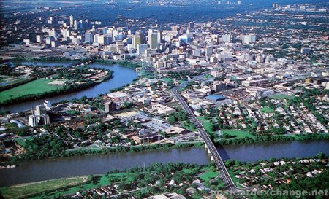
Winnipeg

Slide 3
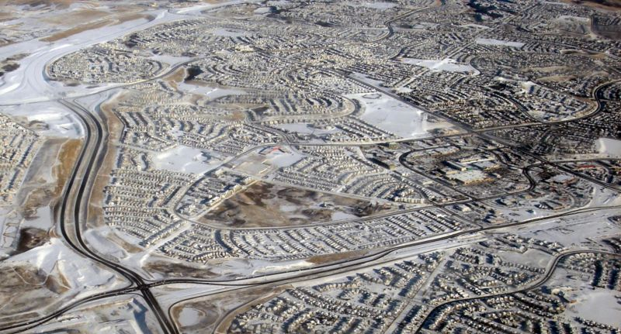
Calgary

Slide 4
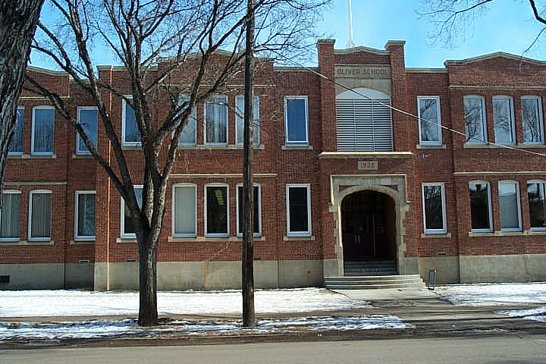
Edmonton

Slide 5
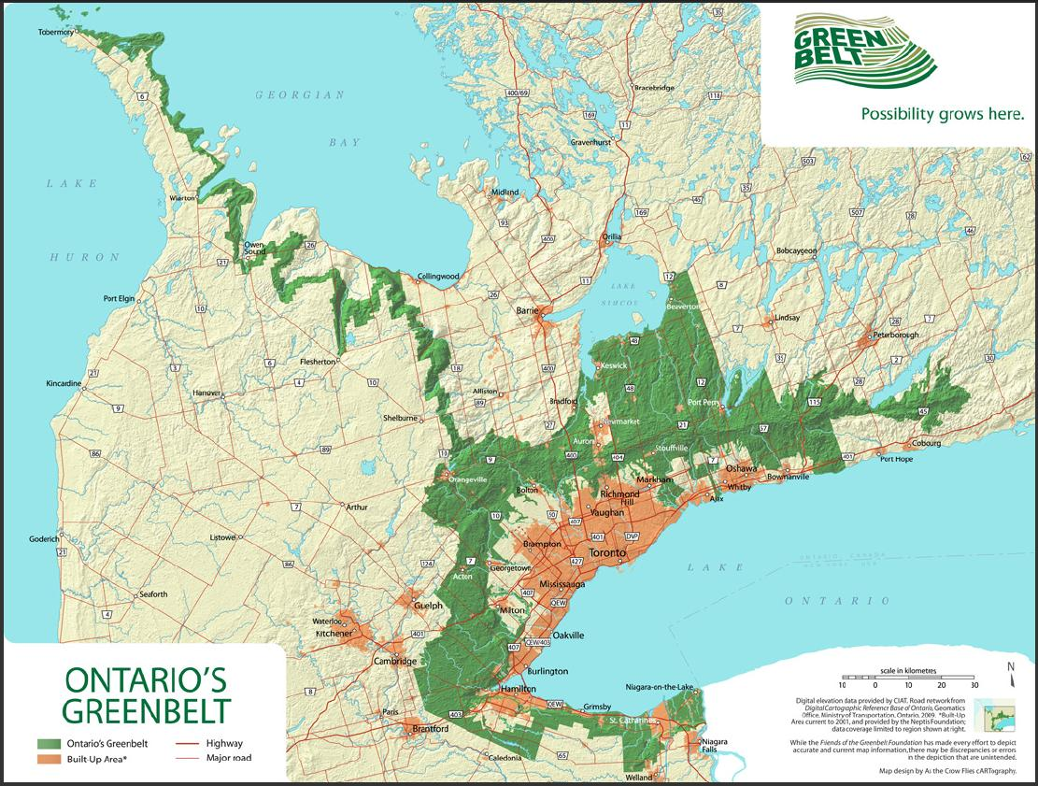
Toronto

Slide 6
What about HRM?

Slide 7
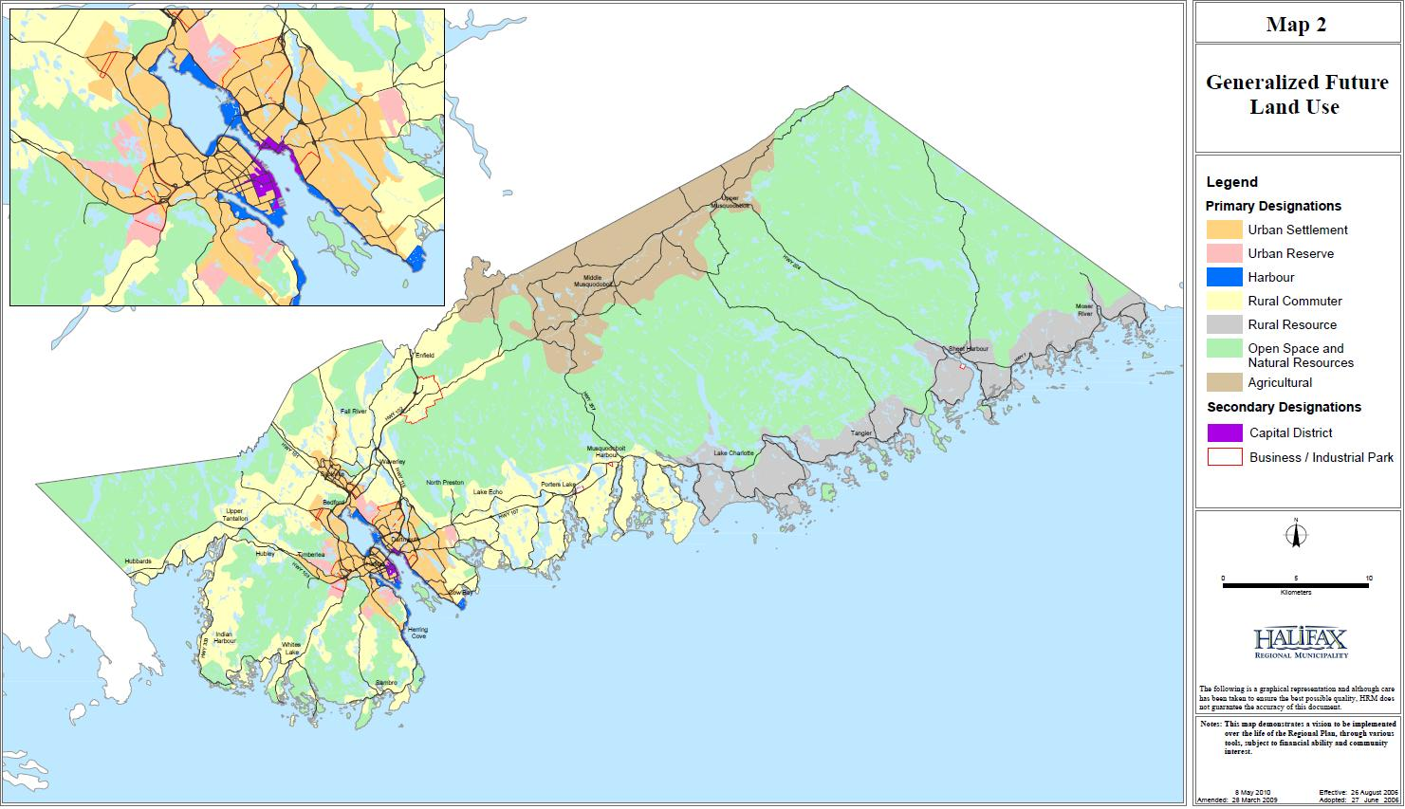
Halifax Regional Municipality

Slide 8
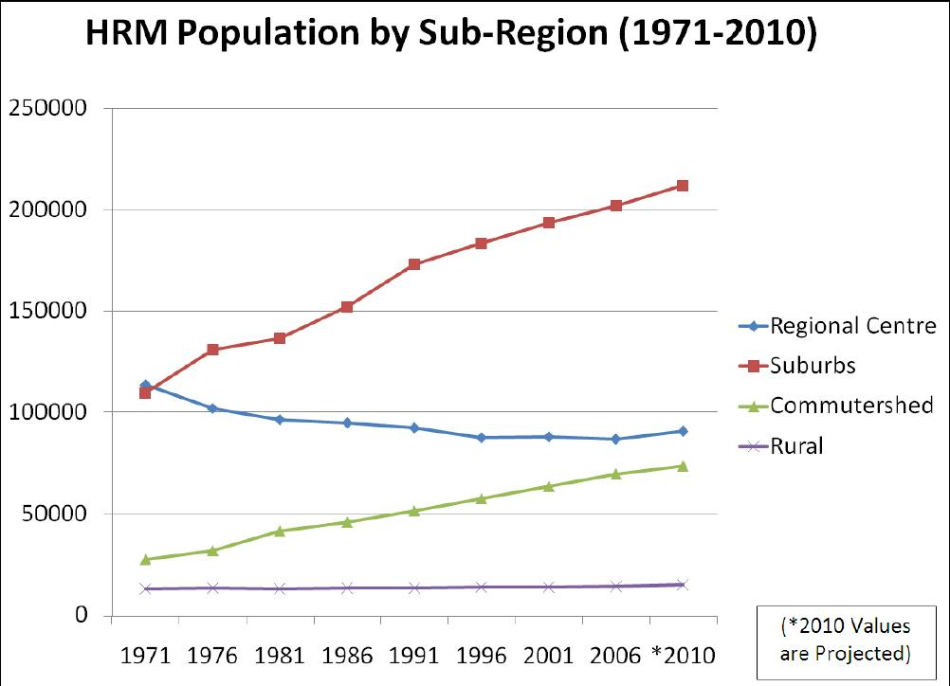

Slide 10
Population Growth Rates
1980-1990
City | City Growth Rate | Suburban Growth Rate
Detroit | 2.12 | -14.56
Toledo | -6.12 | 7.23
Akron | -6.13 | 2.80
Chicago | -7.37 | 7.56
Milwaukee | -1.40 | 5.79
Syracuese | -3.67 | 4.89
St. Louis | -12.39 | 6.41
Philadelphia | -6.08 | 8.02
Rochester | -4.18 | 5.66
Cincinnati | -5.55 | 7.14
Baltimore | -6.46 | 16.52
Kansas City | -2.88 | 14.79
Washington, D.C. | -4.94 | 26.95
Halifax* | -5.26 | 28.57

Slide 11
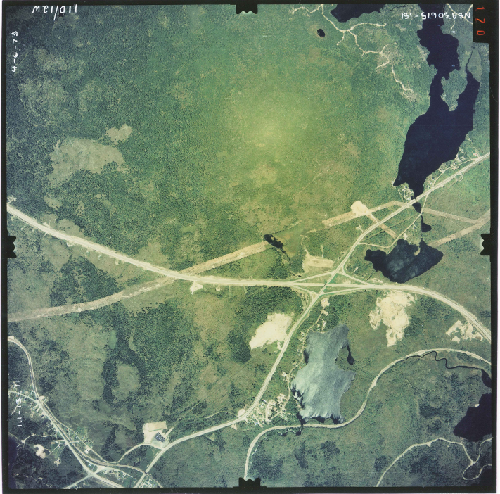
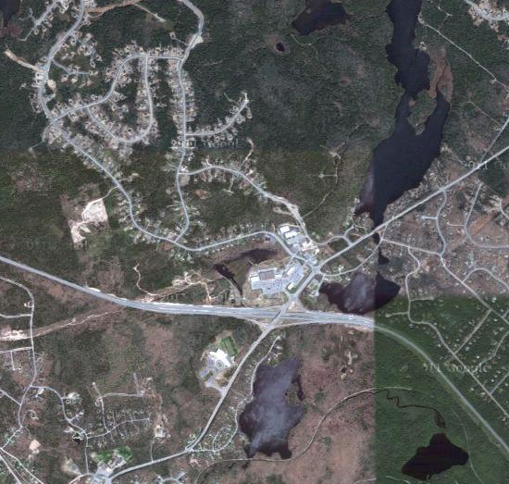
Exit Five
1973
2011

Slide 12
Key objectives of the
Our HRM Alliance
Healthy and active population
Robust transportation systems
Sustainable development
Protected and connected blue and green areas, as well as the primacy of green practices
Vibrant community centres across the entire municipality, including urban, suburban, and rural

Slide 13
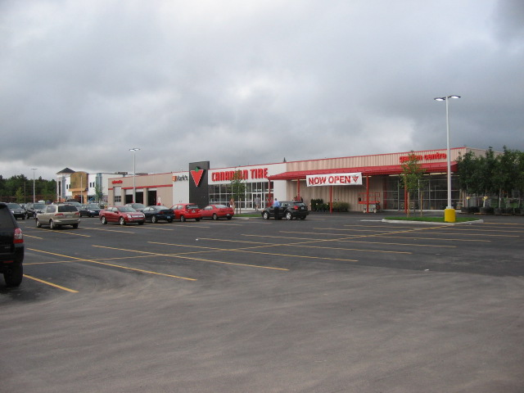
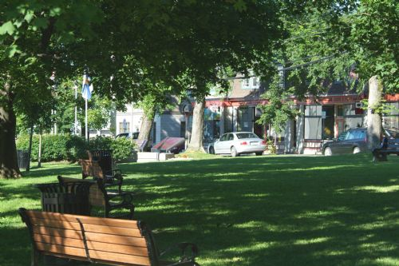
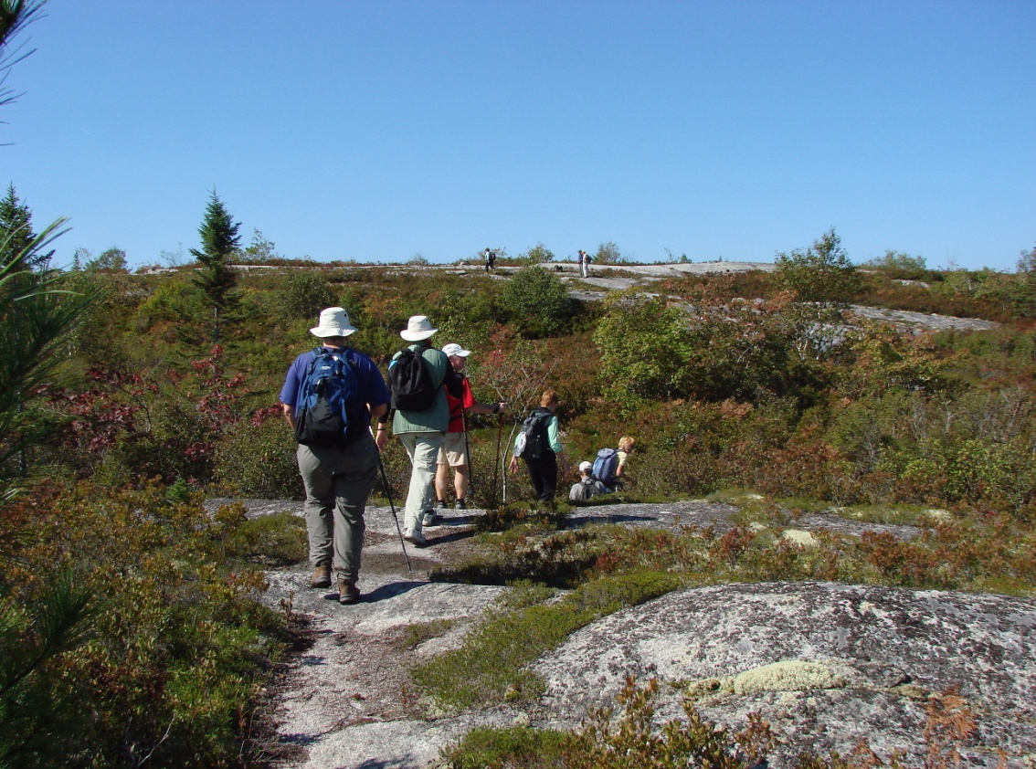

Slide 14
www.ourhrmalliance.ca

