Slide 1
Mineville Wetland Restoration
Compensation Easement with the Municipality as a partner

Slide 2
The Mineville wetland restoration was undertaken as a compensation offset for a wetland impact at another location. The Nova Scotia department of environment have implemented a “No net loss policy on wetlands” which means that if you wish to infill a wetland in one location you must restore or create a wetland in another.

Slide 3
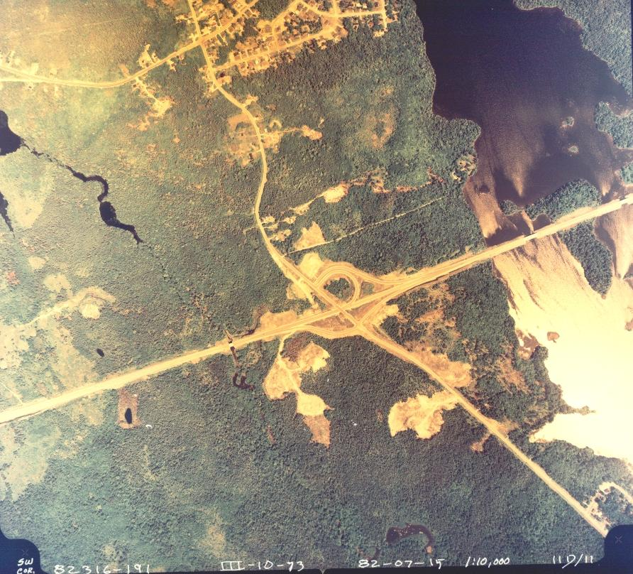
The site was chosen because of the impact of human activity that occurred when the highway was built. The project was designed by Strum Environmental and approved by NSE. The plan is to recreate the natural habitat that was lost. This entailed the removal of the material placed into the wetland and to create a number of cells that will retain both rain and ground water and slowly release into the existing wetland. Once the correct hydrology is achieved the natural vegetation will re-establish throughout the restored area.

Slide 4
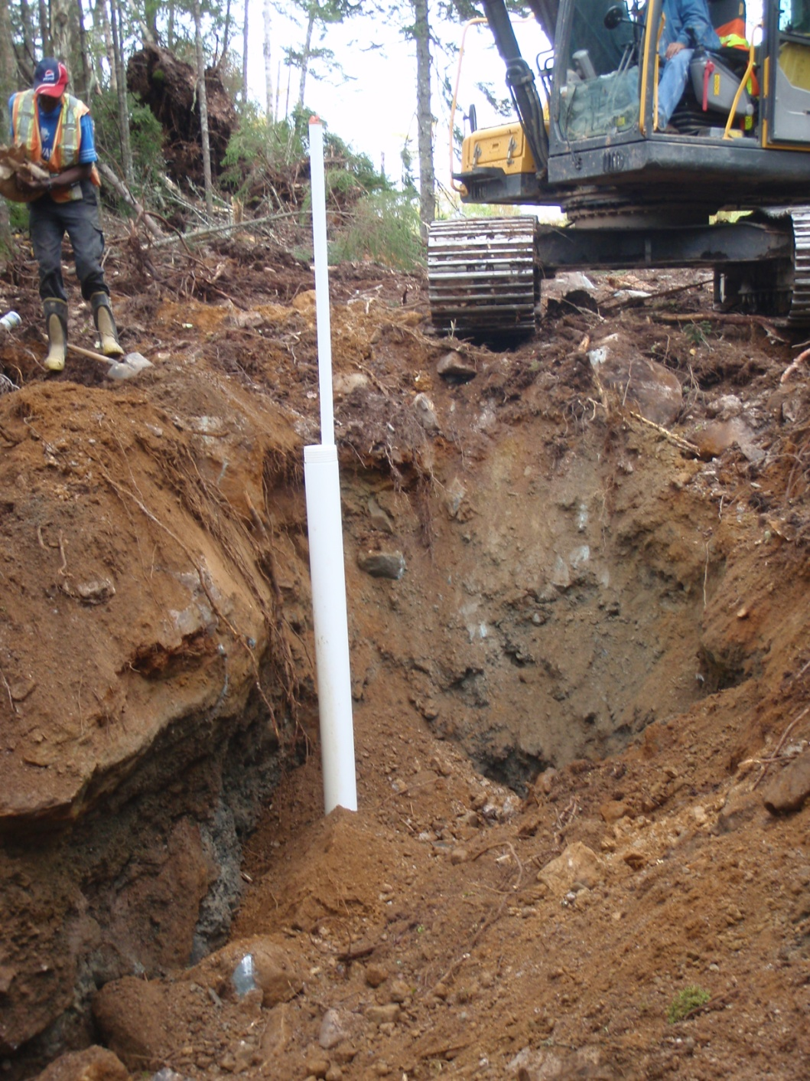
The project began in 2009 with the installation of 24 monitoring wells to measure the ground water levels and establish a baseline. After a year of monitoring and review a construction plan was prepared and construction began in June of 2010. Excavation took approximately two months and was completed in August of 2010. Construction began at the northerly portion of the site and progressed to the south. Before the completion of the construction, wetland vegetation had already begun to re-establish in the first cells that were created.

Slide 5
What happens next?
The site will be monitored by the environmental consultant over the next five years to assess the hydrology of the site, both in the newly created cells as well as the existing wetland. They will also provide a quantitative review of the re-vegetation and wildlife as the wetland evolves. The consultant will submit annual reports to NSE on the progress of the wetland.

Slide 6
What is a Conservation Easement?
It is an agreement between a property owner and an eligible recipient that grants rights and privileges to the recipient for the purpose of conservation and is registered against title. As per the NSE approval the property owner is required to protect the site with a Conservation Easement. There are a number of approved organizations that are eligible recipients of a Conservation Easement including Municipalities. There is a Provincial Act which sets out the contents of the agreement and copies are available for review.

Slide 7
Are there any costs or liabilities to the Municipality?
The simple answer is no, however there is a responsibility to ensure that the rights and privileges are enforced under the agreement.

Slide 8
What are the benefits to the community?
The Conservancy Easement will ensure that no development occurs behind Bennett park and remains in a natural state. This will provide additional habitat for wildlife and for those who enjoy the trails through the park.

Slide 9
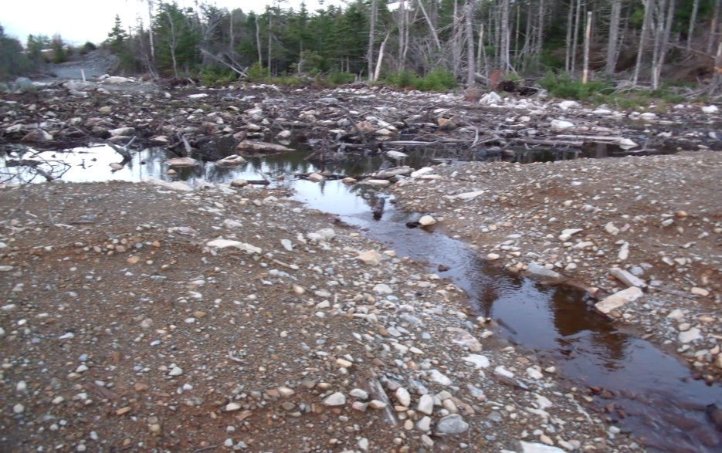
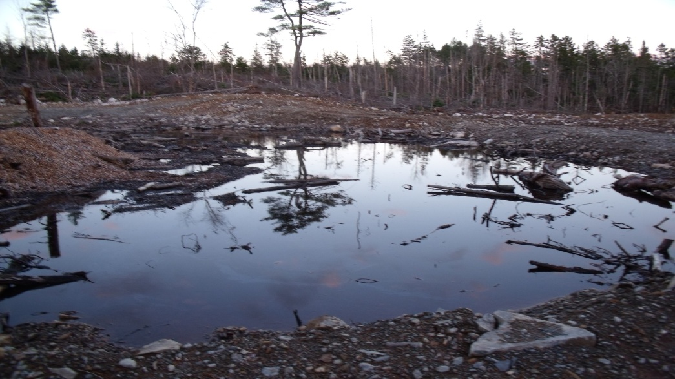
How did the wetland perform in the recent rain event?
On November 12th through the 14th the area received nearly 200mm of rain. Rain accumulated in the cells and water levels ranged from 200mm to 500mm, excess water flowed through the swales as designed by the environmental consultant. No siltation was observed.

Slide 10
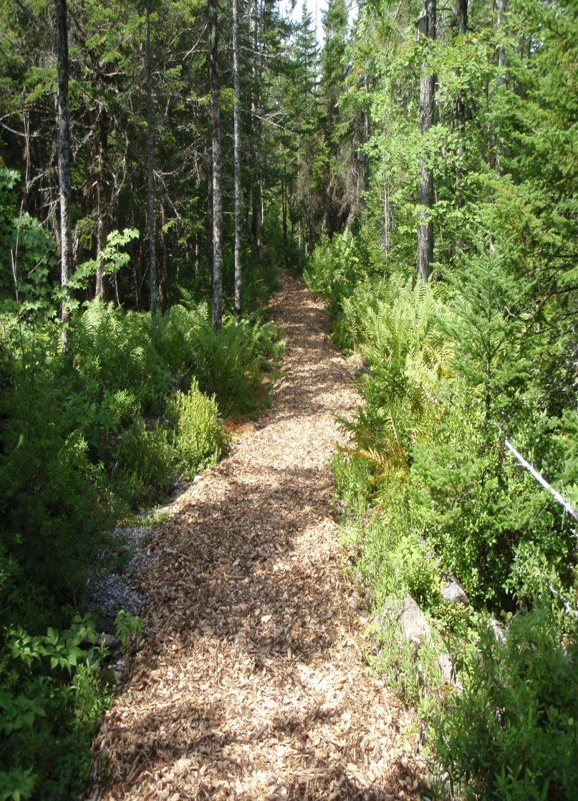
Is the community interested in receiving the Conservancy easement?
Both the Federal and Provincial governments have recognised the importance of protecting wetlands. The Federal government, by providing tax incentives for placing environmentally sensitive land into conservancy easements and the Provincial Government by creating the legislation to protect these lands. There are a number of eligible recipients including the municipality. Where the property abuts the municipal park and where the community participates in the management of the park, I felt it prudent to offer the opportunity to the community first.

