Slide 1
HRM Urban Forest Master Plan

Slide 2
HRM Urban Forest Master Plan
HRM’s Urban Forest
History
Themes in the Plan
Management Framework
Status of the Plan Today

Slide 3
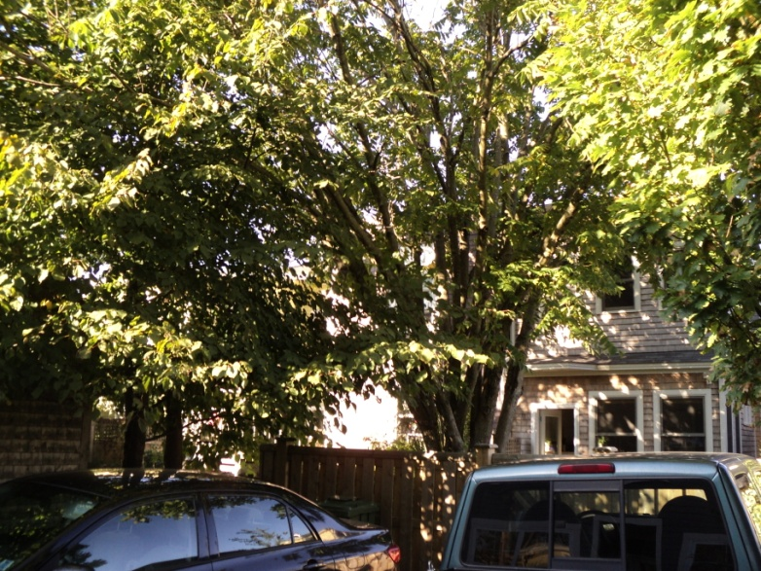
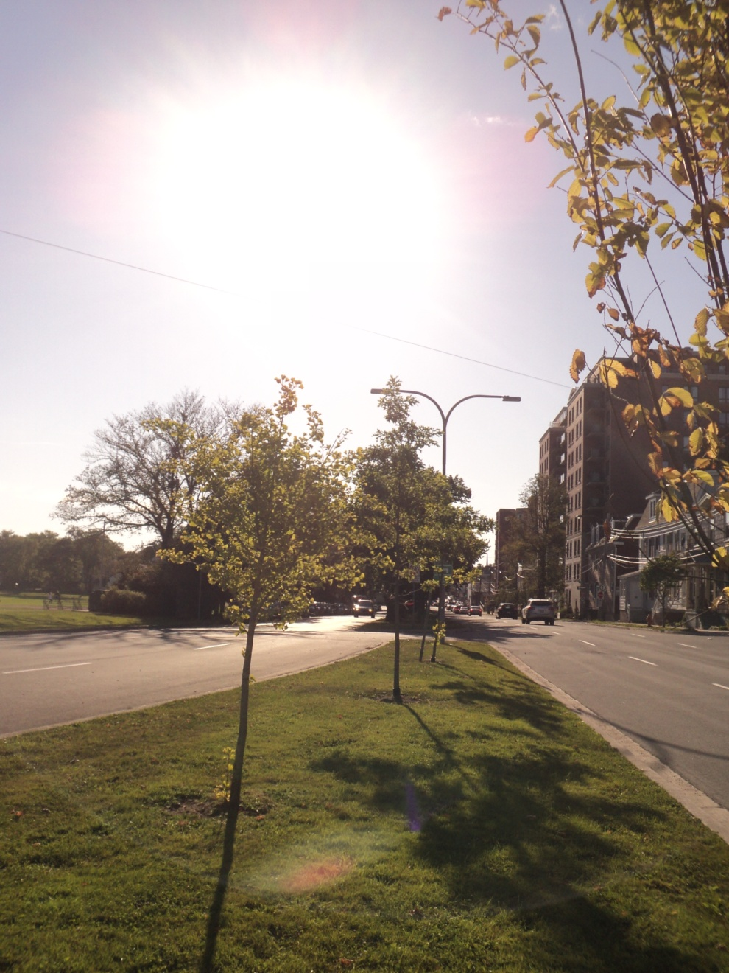
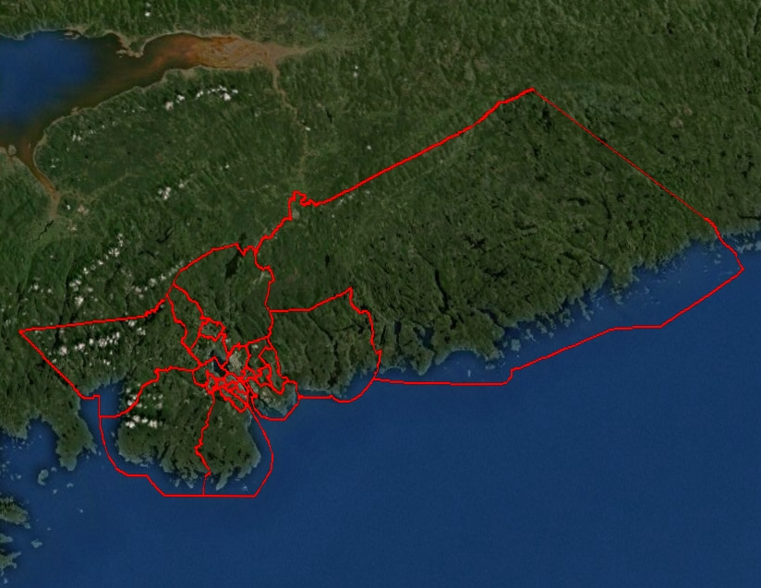
HRM’s Urban Forest
The peri-urban forest → Halifax
is expanding
157,000 HRM-owned street trees
Private residential trees

Slide 4
Challenges
Development
Species and age-class diversity (Norway maple, over mature street trees)
Construction/conflict with infrastructure
Imperviousness/plantable sites
Invasive species (DED, EAB, ALB, and many other acronyms)
Climate change
Lack of knowledge

Slide 5
History and Genesis of the Plan

Slide 6
Halifax’s urban forest in 1750: dark and dangerous surrounding forest… and the gallows tree

Slide 7
History
Trees cleared for development and strategic reasons (Citadel and forts)
Trees widely planted in early/mid 20th century
European influence → Prolific Norway maple, elm, and linden
Lack of management (and tree planting) in late 20th century
Advent of research, management plans, model, tools, etc. for SUFM -2000-2011

Slide 8
Genesis of the Plan
Regional Council Motion - 2001
HRM UFMP policy in 2006 Regional Plan
Dalhousie/HRM collaboration 2007-2011
UFORE, STRATUM,LiDAR,GIS
Public Engagement 2010
UFMP Team
Dalhousie: Peter Duinker, James Steenberg, Gary Davidson, Jen Ross, Justin Hack
HRM: John Charles, Peter Bigelow, John Simmons

Slide 9
Themes in the Plan: The Neighbourhood Approach

Slide 10
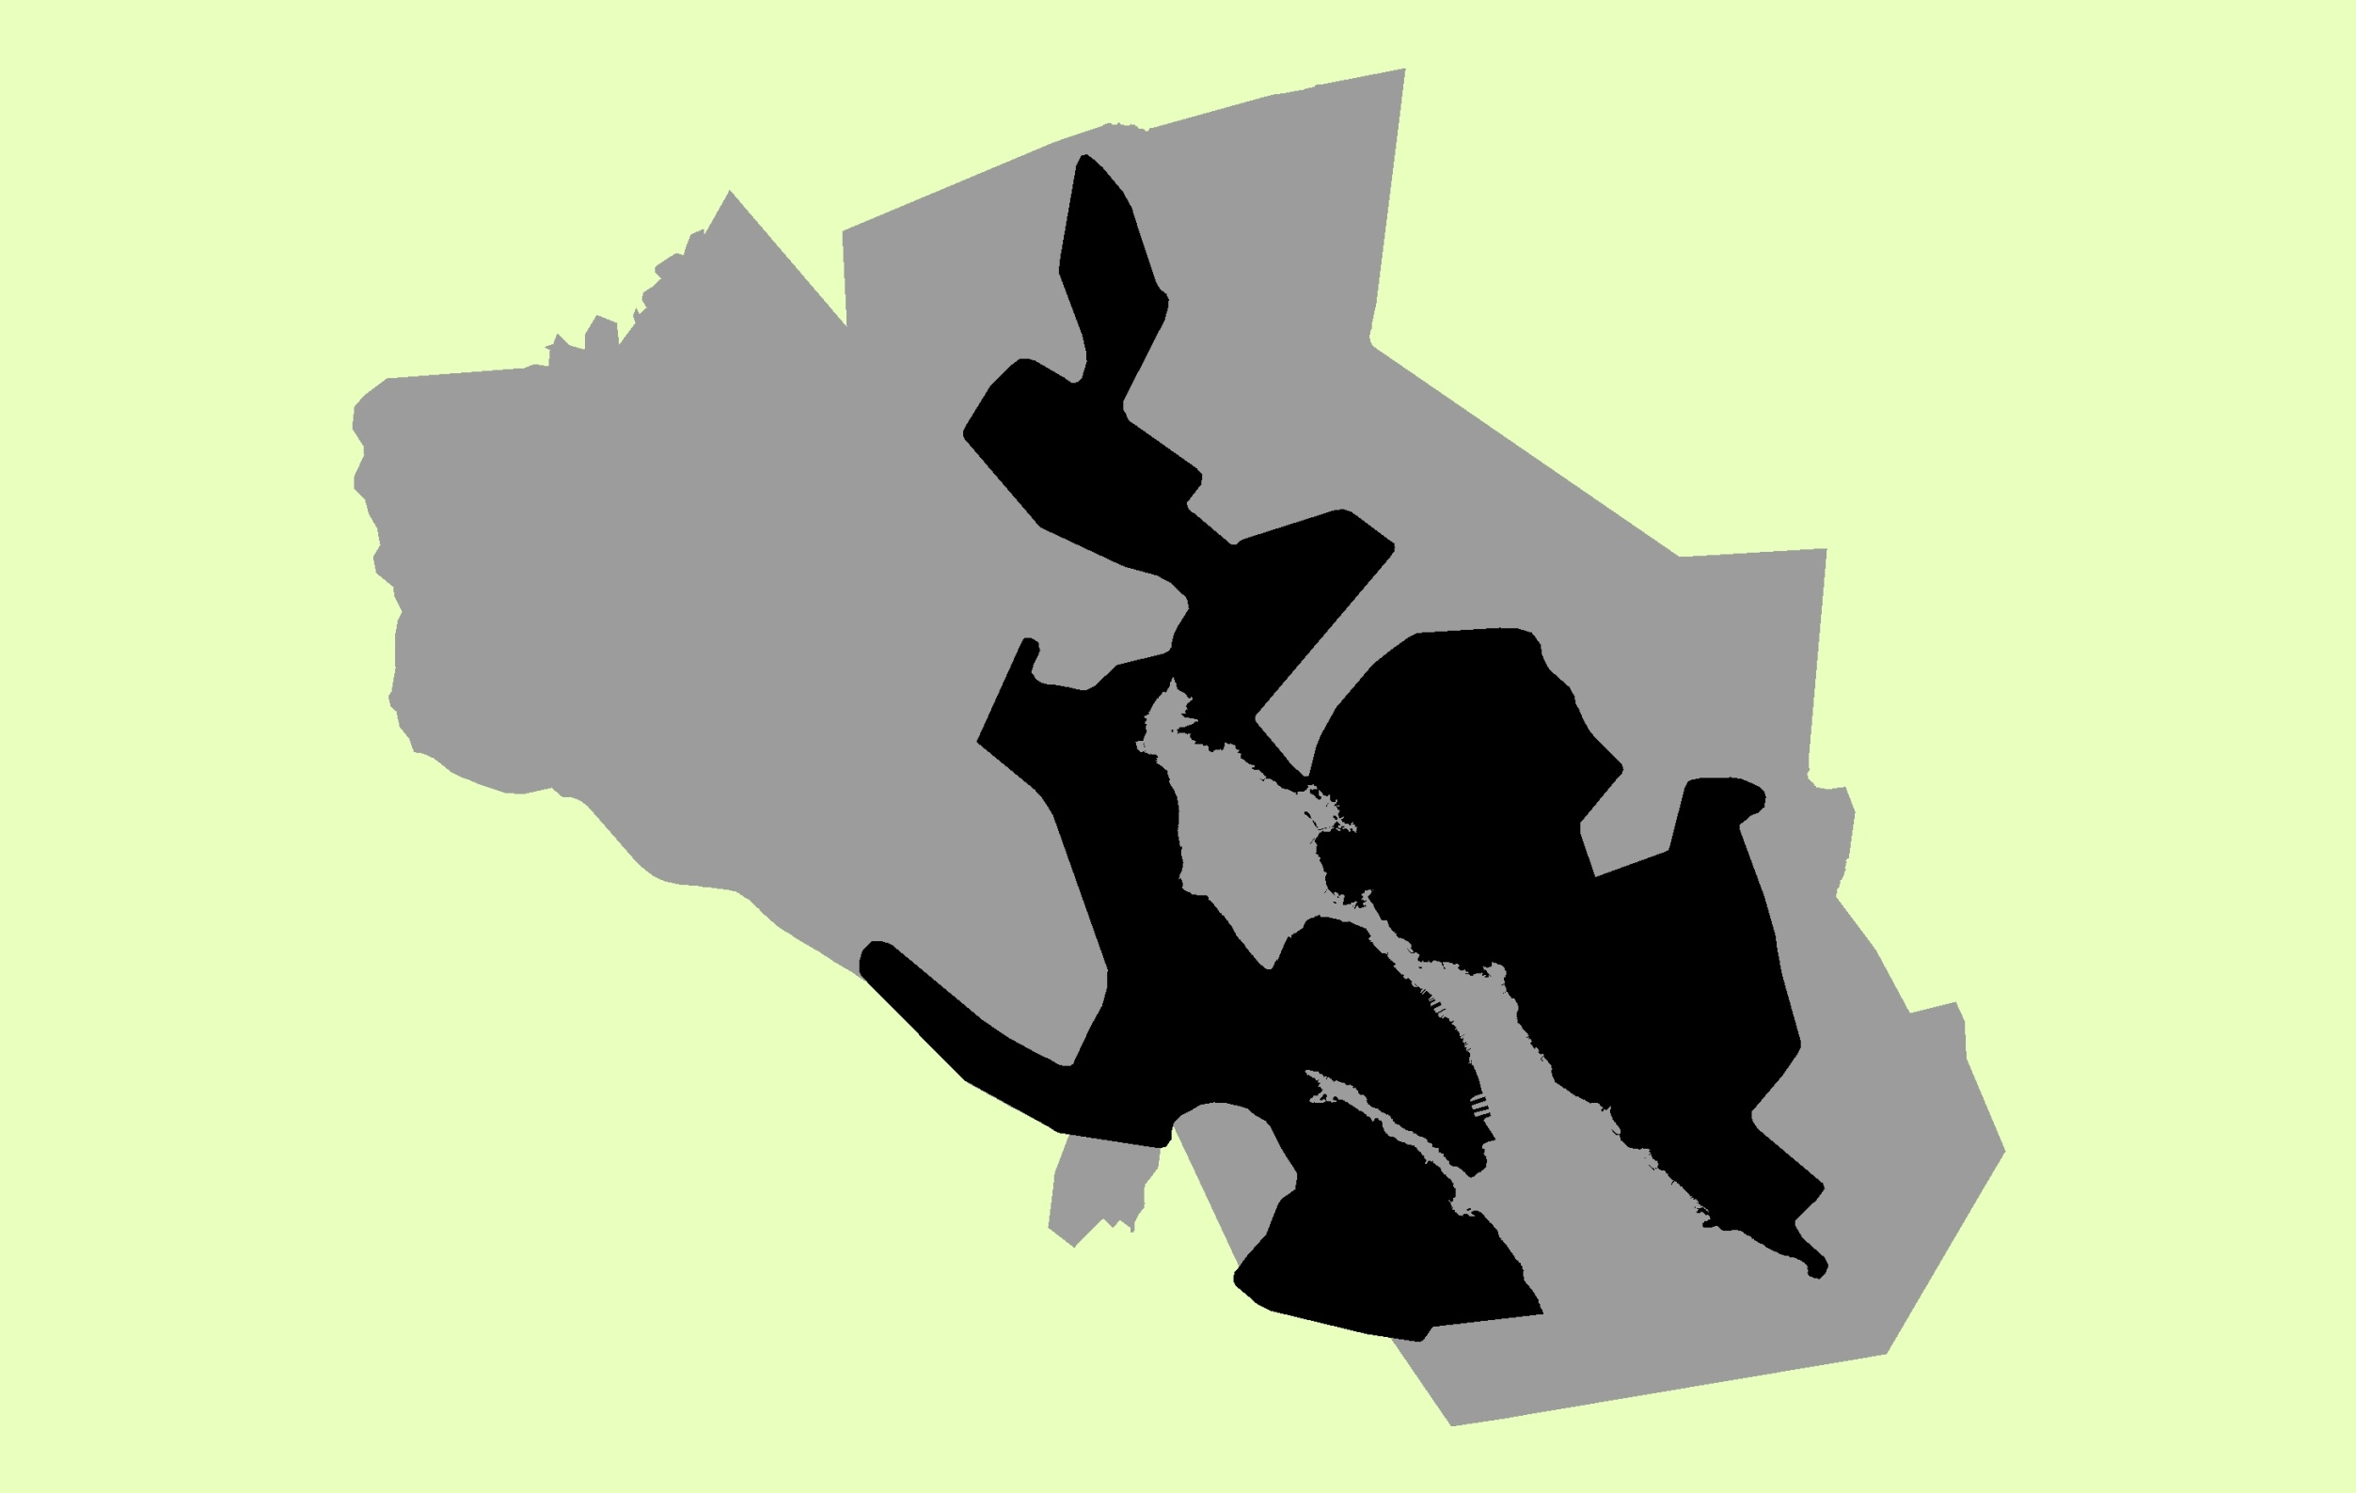
UFMP Study Area

Slide 11
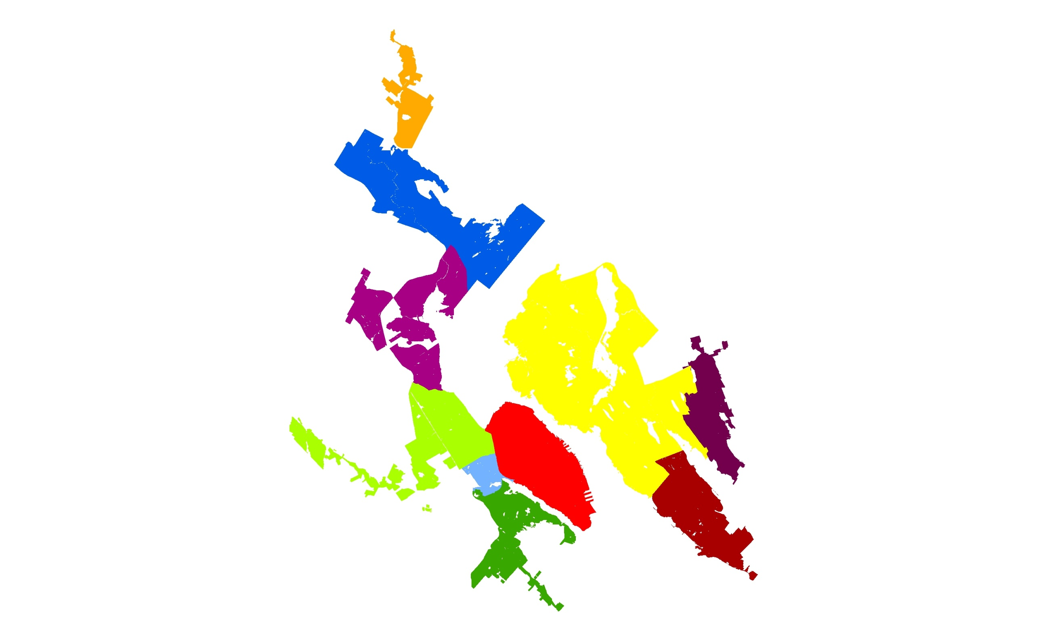
10 Communities

Slide 12
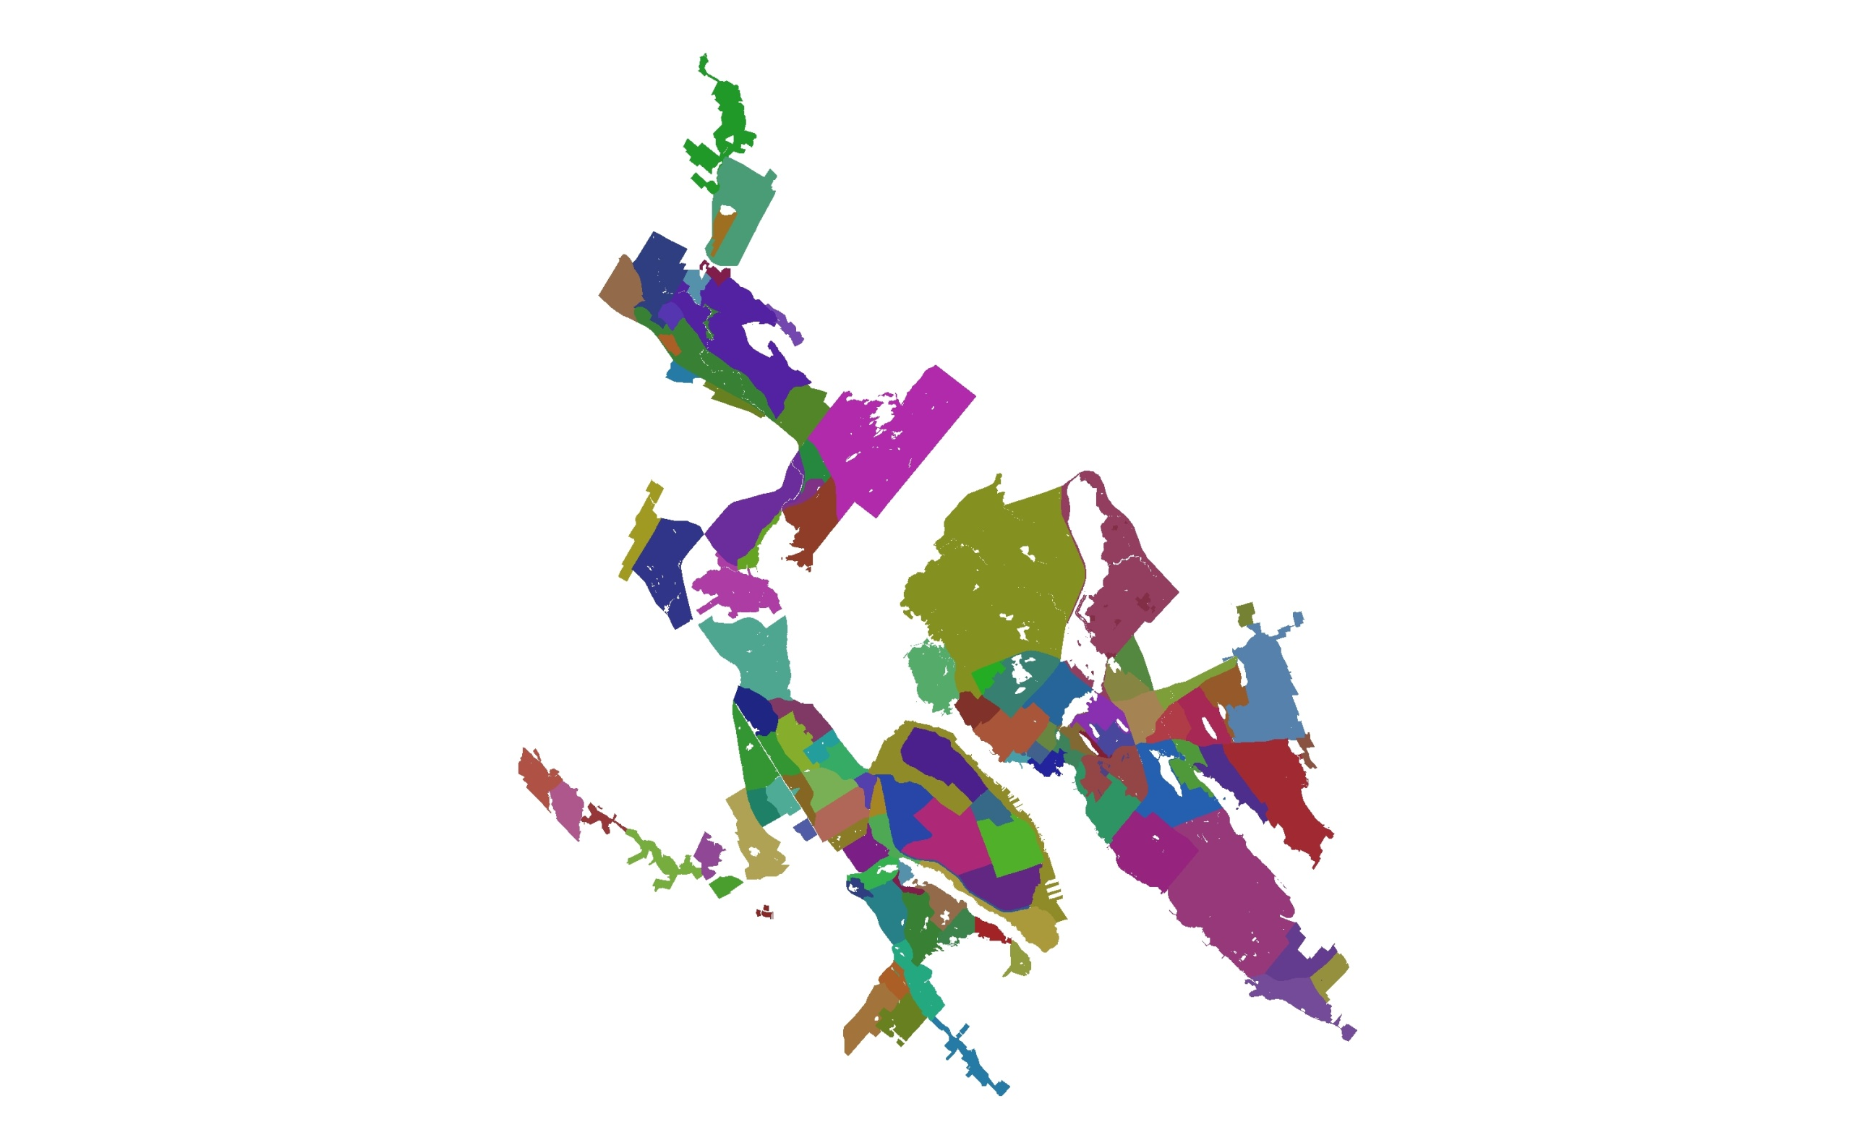
111 Neighbourhoods

Slide 13
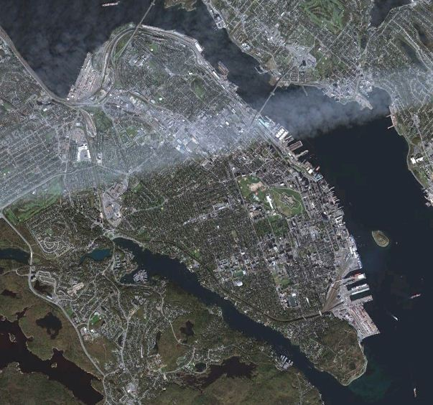
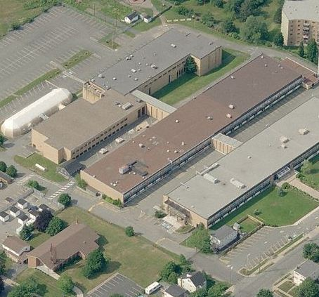
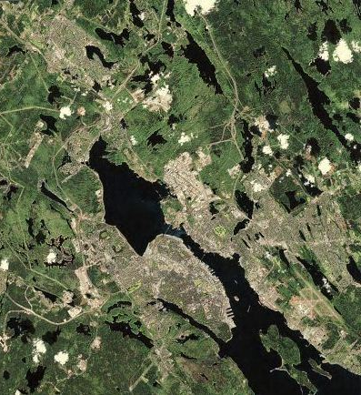
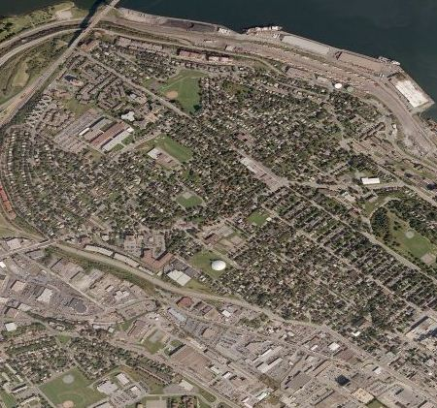
Four Scales of UF Management
UFMP Study Area
Community
Neighbourhood
Neighbourhood Division

Slide 14
Neighbourhood Analysis

Slide 15
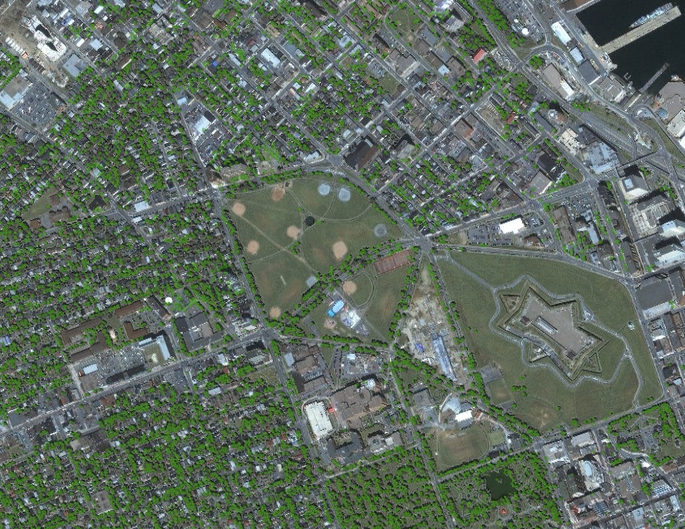
Urban Forest Canopy Data

Slide 16
Neighbourhood Canopy Targets
North End: 70%
Stadacona: 20%
Mulgrave Park: 20%
NSCC: 20%
Novalea Centre: 20%
Oland Brewery: 20%
Parks: 40%

Slide 17
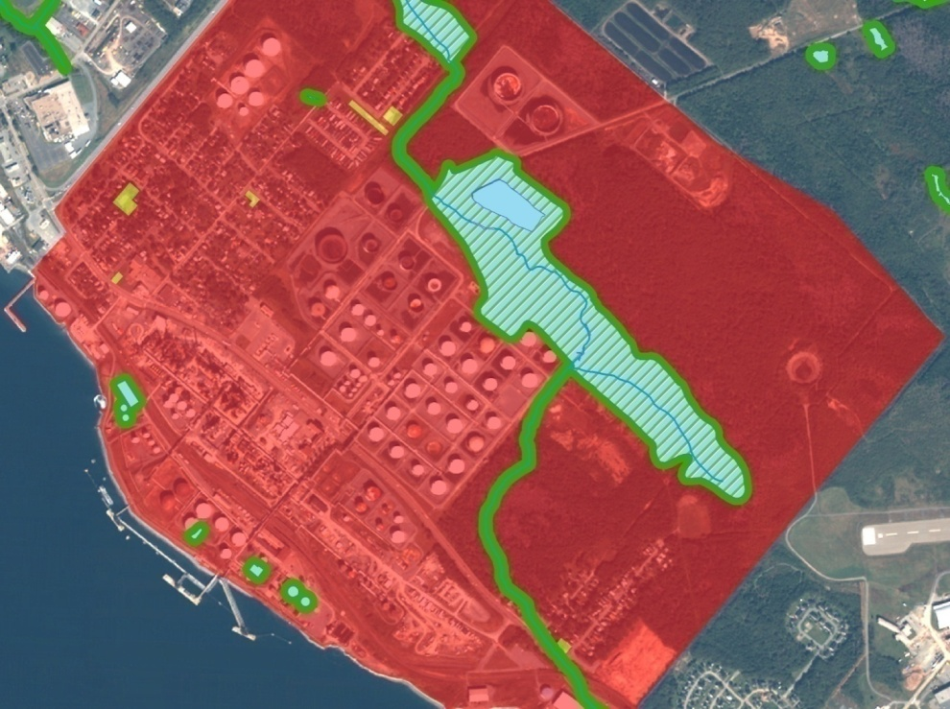
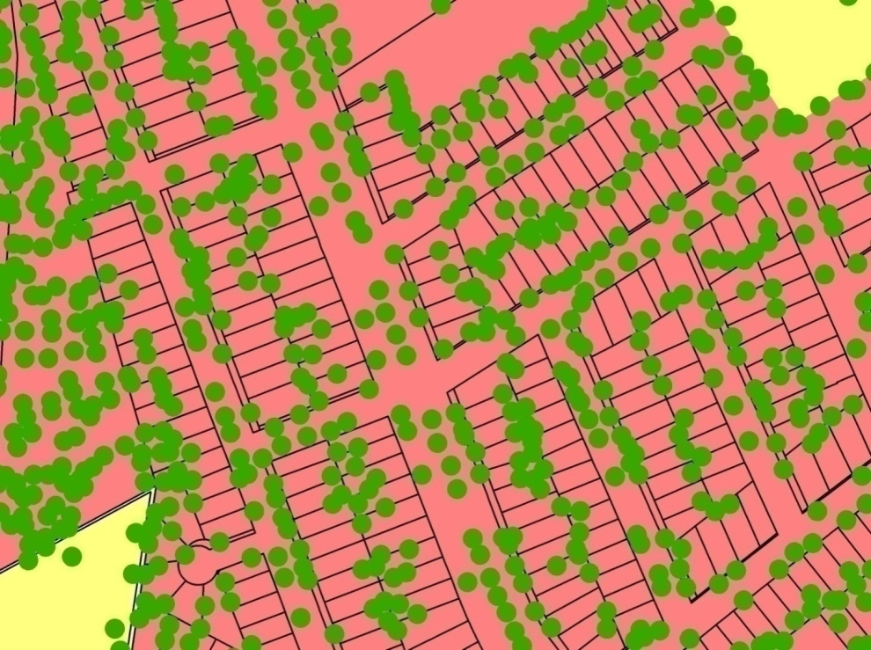
Forest stands/ naturalized areas
Riparian zones
Value trees

Slide 18
STRATUM

Slide 19
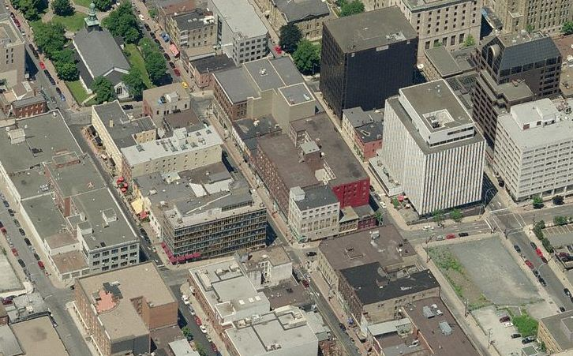
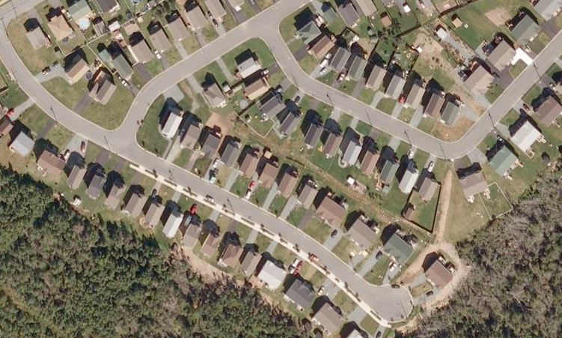
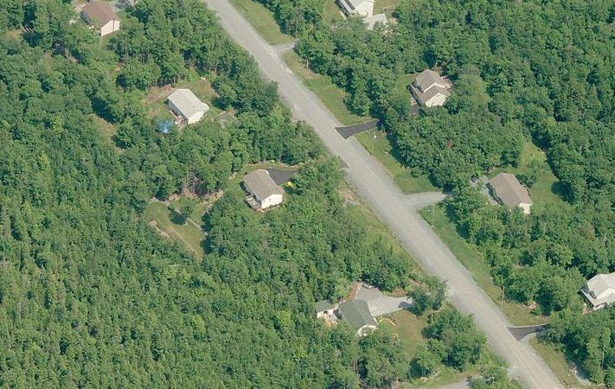
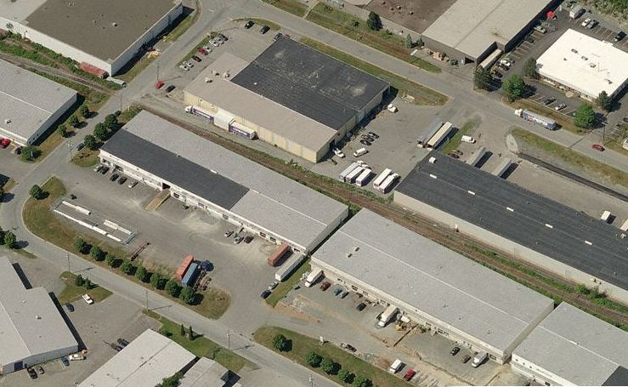
Neighbourhood Types

Slide 20
Landscape Pattern Language
Notes:
.

Slide 21
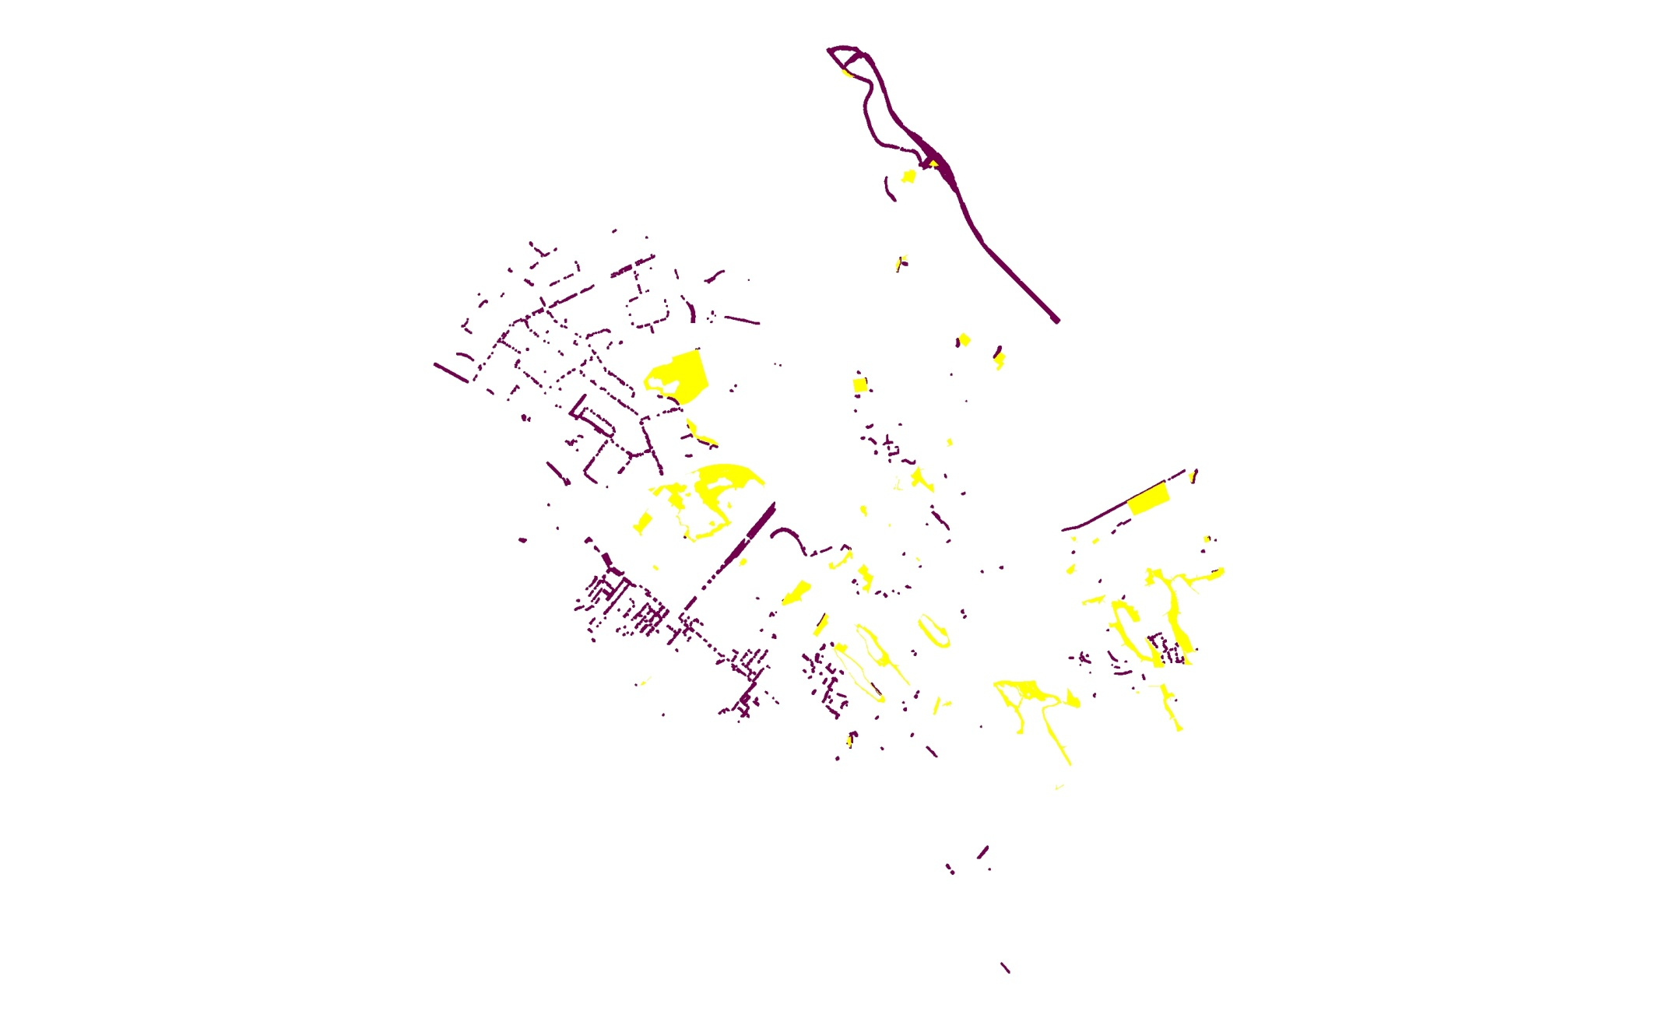
Dartmouth Today
Network
Patchwork
Ribbon
Belt
Wedge

Slide 22
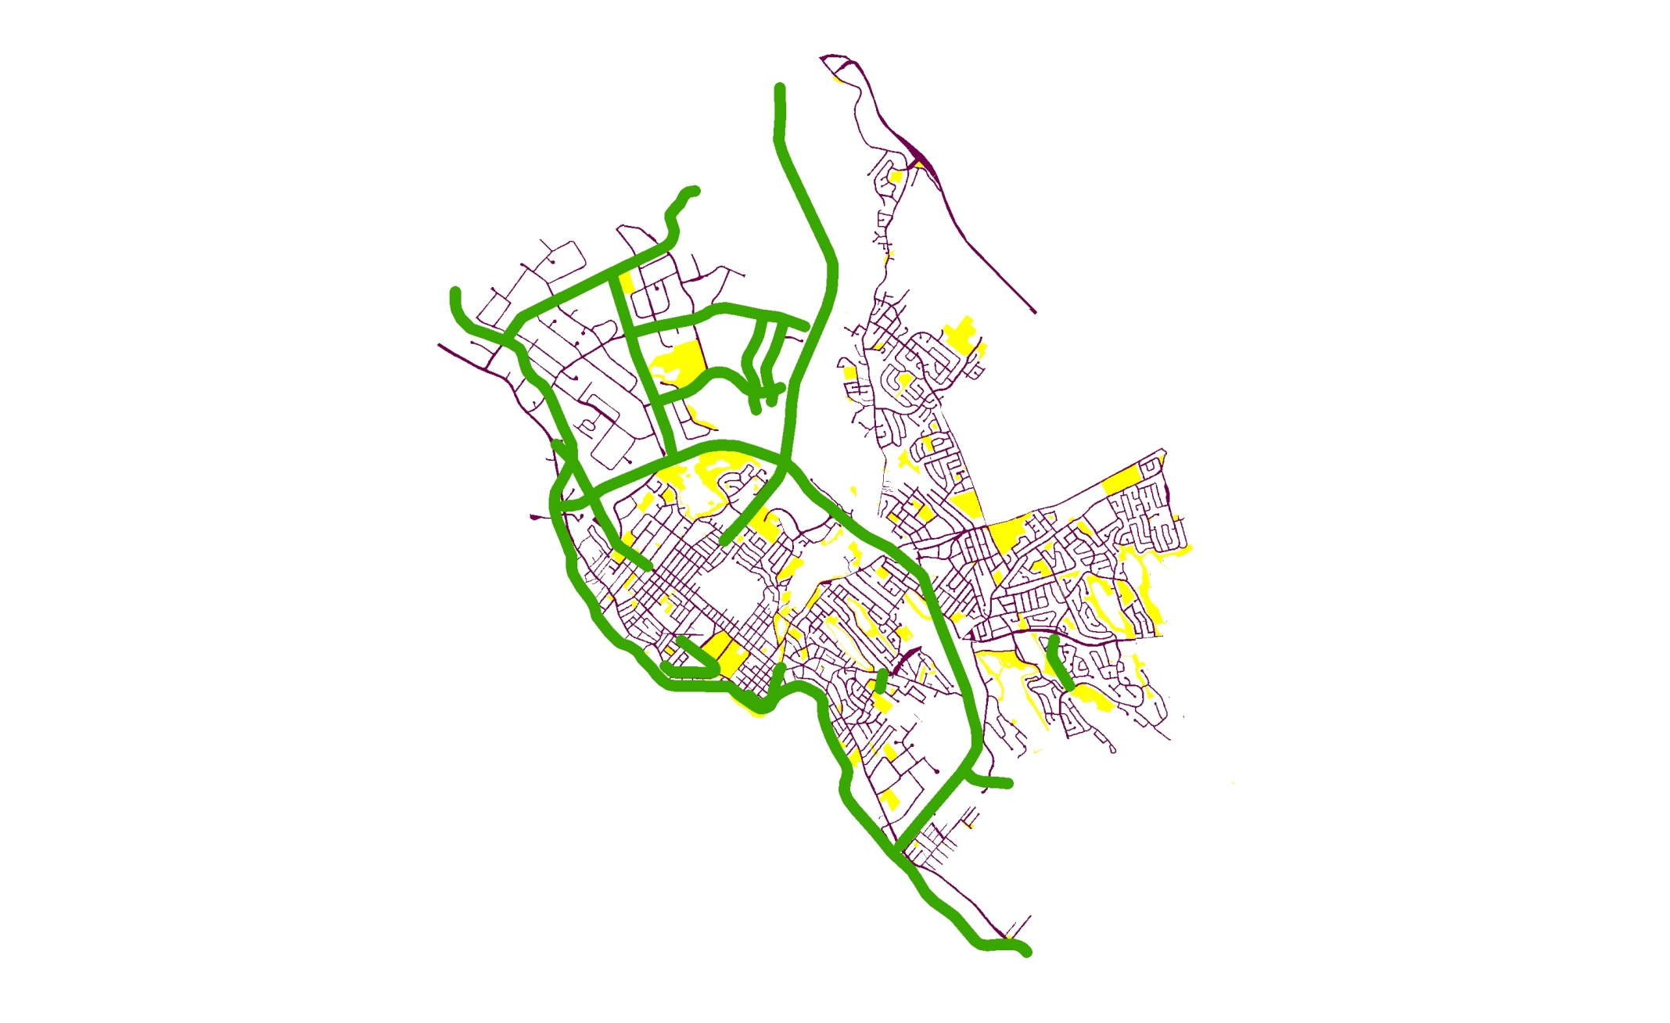
Dartmouth Tomorrow
Network
Patchwork
Ribbon
Belt
Wedge

Slide 23
The Management Framework

Slide 24
Operational Principles
Comprehensive approach
Urban forest values
Space and location
Time and timing
Climate change
Naturalness
Invasive species
Public understanding
Stewardship
Priority-setting
Green infrastructure
Sense of identity
Cooperation and partnerships
Equity
Integrated planning

Slide 25
Values, Objectives, Indicators, Targets (VOITs)

Slide 26
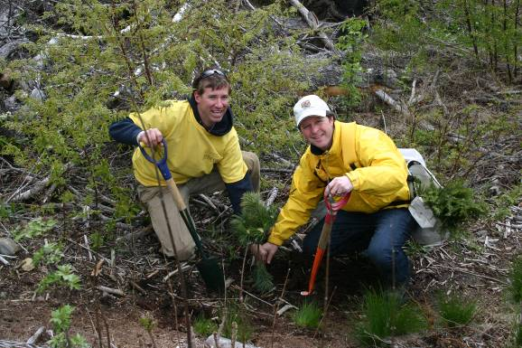
Actions
Three major types of actions:
Actions derived from VOITs
Actions derived from Operational Principles
Policy-based actions (e.g. MPS,LUB amendments).

Slide 27
Status of the Plan
VOIT development in summer, 2010
Community engagement in summer, 2010
Neighbourhood classification and analysis in spring/summer, 2011
Management framework development in summer, 2011
First draft completed in early September, 2011
Plan released to Steering Committee and public in fall, 2011
Regional Council, 2012

